Slide 1
Getting Started with GUI Programming
GUI Class Hierarchy
Frames
Creating frames, centering frames, adding components to frames
Layout Managers
FlowLayout, GridLayout, BorderLayout
Panels
The paintComponent method
Using Colors, Fonts, and Font Metrics
Event-Driven Programming
Event Source, Listener, Listener Interface

Slide 2
GUI Class Hierarchy (Swing)

Slide 3
JComponent

Slide 4
AWT (more heavy weight parts)

Slide 5
Frames
Frame: a window that is not contained inside another window. Frames contain other user interface components in Java GUI applications.
For Swing GUI programs, use JFrame class to create windows.

Slide 6
Creating Frames
import javax.swing.*;
public class MyFrame {
public static void main(String[] args) {
JFrame frame=new JFrame("Test Frame");
frame.setSize(400, 300);
frame.setVisible(true);
frame.setDefaultCloseOperation(
JFrame.EXIT_ON_CLOSE);
}
}
Run

Slide 7
Frame Location
By default, a frame is displayed in the upper-left corner of the screen.
To display a frame at a specified location, use the setLocation(x, y) method in the JFrame class. This method places the upper-left corner of a frame at location (x, y).

Slide 8
Centering a Frame
CenterFrame
Run

Slide 9
Adding Components into a Frame
// Add a button into the frame
frame.getContentPane().add(new JButton("OK"));
MyFrameWithComponents
Run

Slide 10
NOTE
A JFrame object uses the content pane to hold components in the frame. The content pane is an instance of Container within the frame. The statement in the preceding slide can be replaced by the following two lines:
Container container=frame.getContentPane();
container.add(new JButton("OK"));
.

Slide 11
Layout Managers
Java’s layout managers provide a level of abstraction to automatically map your user interface on all window systems.
The UI components are placed in containers. Each container has a layout manager to arrange the UI components within the container.

Slide 12
Kinds of Layout Managers
FlowLayout
GridLayout
BorderLayout
GridBagLayout

Slide 13
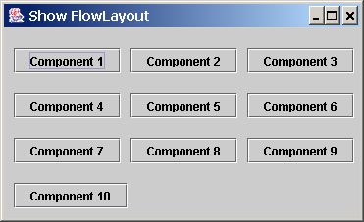
Testing the FlowLayout Manager
The components are arranged in the container from left to right in the order in which they were added. When one row becomes filled, a new row is started.
ShowFlowLayout
Run

Slide 14
Multiple FlowLayout Constructors
public FlowLayout(int align, int hGap, int vGap)
Constructs a new FlowLayout with a specified alignment, horizontal gap, and vertical gap. The gaps are the distances in pixels between components.
public FlowLayout(int alignment)
Constructs a new FlowLayout with a specified alignment and a default gap of five pixels for both horizontal and vertical.
public FlowLayout()
Constructs a new FlowLayout with a default center alignment and a default gap of five pixels for both horizontal and vertical.

Slide 15
Testing the GridLayout Manager
The GridLayout manager arranges components in a grid (matrix) formation with the number of rows and columns defined by the constructor. The components are placed in the grid from left to right starting with the first row, then the second, and so on.
ShowGridLayout
Run

Slide 16
Mulitple GridLayout Constructors
public GridLayout(int rows, int columns)
Constructs a new GridLayout with the specified number of rows and columns.
public GridLayout(int rows, int columns, int hGap, int vGap)
Constructs a new GridLayout with the specified number of rows and columns, along with specified horizontal and vertical gaps between components.

Slide 17
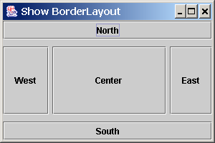
Testing the BorderLayout Manager
ShowBorderLayout
Run

Slide 18
Using Panels as Containers
Panels act as smaller containers for grouping user interface components.
It is recommended that you place the user interface components in panels and place the panels in a frame. You can also place panels in a panel.

Slide 19
UI Components

Slide 20
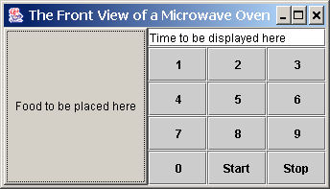
Panels
This example uses panels to organize components.
TestPanels
Run

Slide 21
Setting Colors
You can use the following methods to set the component’s background and foreground colors:
setBackground(Color c)
setForeground(Color c)
Example:
setBackground(Color.yellow); setForeground(Color.red); http://java.sun.com/j2se/1.4.2/docs/api/java/awt/Color.html
BLACK, BLUE, CYAN, PINK, etc.

Slide 22
Event-Driven Programming
Procedural programming is executed in procedural order.
In event-driven programming, code is executed upon activation of events.

Slide 23
Events
An event can be defined as a type of signal to the program that something has happened.
The event is generated by external user actions such as mouse movements, mouse button clicks, and keystrokes, or by the operating system, such as a timer.

Slide 24
Event Information
id: A number that identifies the event.
target: The source component upon which the event occurred.
arg: Additional information about the source components.
x, y coordinates: The mouse pointer location when a mouse movement event occurred.
clickCount: The number of consecutive clicks for the mouse events. For other events, it is zero.
when: The time stamp of the event.
key: The key that was pressed or released.

Slide 25
The Delegation Model

Slide 26
Selected Event Handlers
Event Class Listener Interface Listener Methods (Handlers) ActionEvent ActionListener actionPerformed(ActionEvent)
ItemEvent ItemListener itemStateChanged(ItemEvent)
WindowEvent WindowListener windowClosing(WindowEvent)
windowOpened(WindowEvent)
windowIconified(WindowEvent)
windowDeiconified(WindowEvent)
windowClosed(WindowEvent)
windowActivated(WindowEvent)
windowDeactivated(WindowEvent)
ContainerEvent ContainerListener componentAdded(ContainerEvent)
componentRemoved(ContainerEvent)

Slide 27
Handling Simple Action Events
Objective: Display two buttons OK and Cancel in the window. A message is displayed on the console to indicate which button is clicked, when a button is clicked.
TestActionEvent
Run

